Slide 1
What do we do as an imaging data scientist?

Slide 2
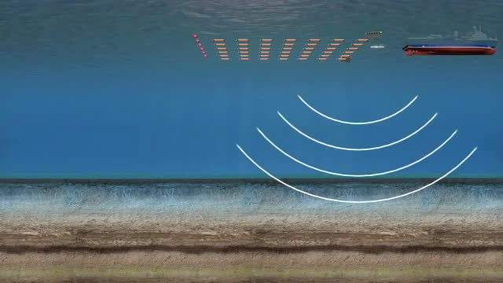
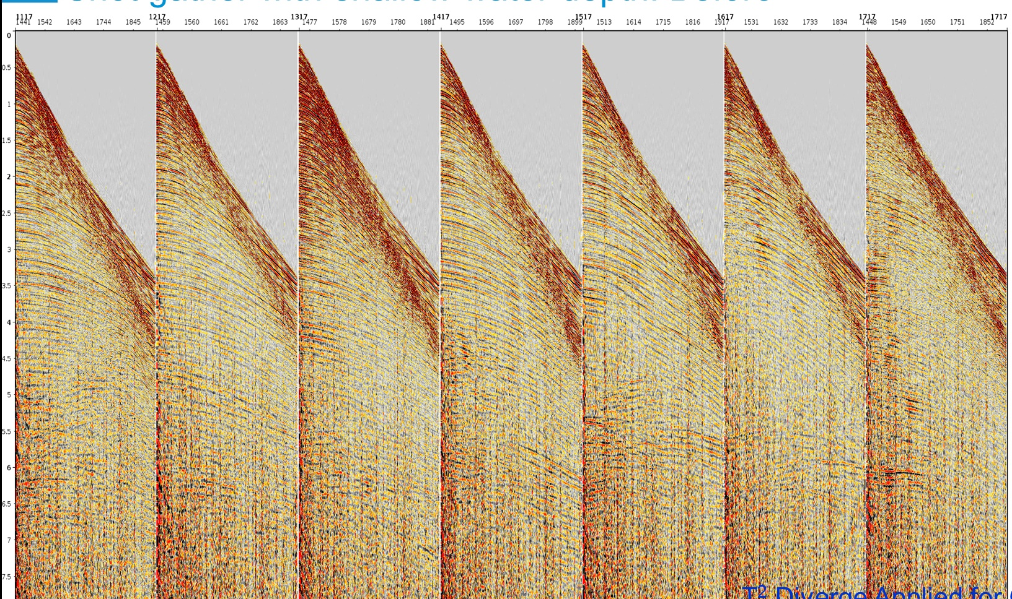
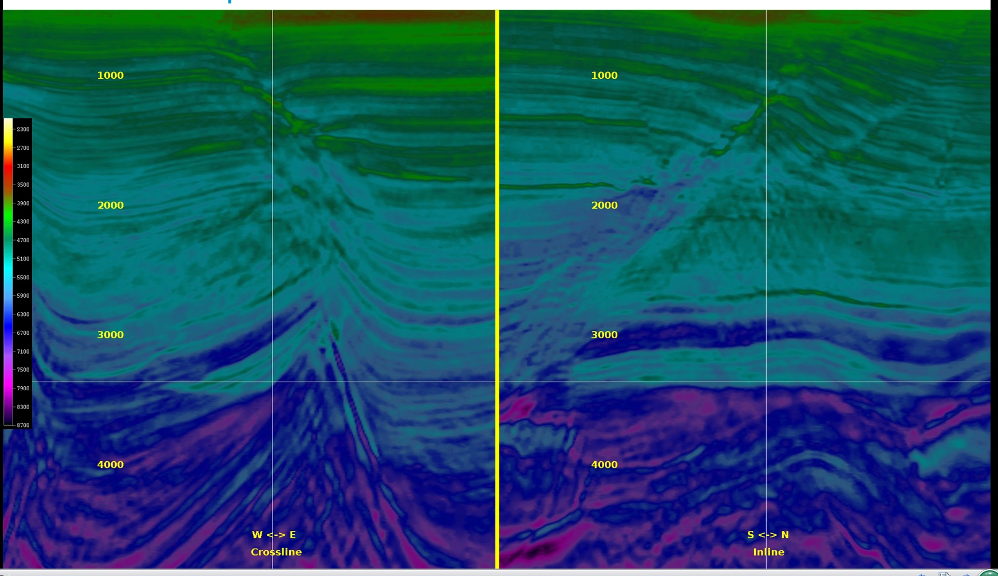
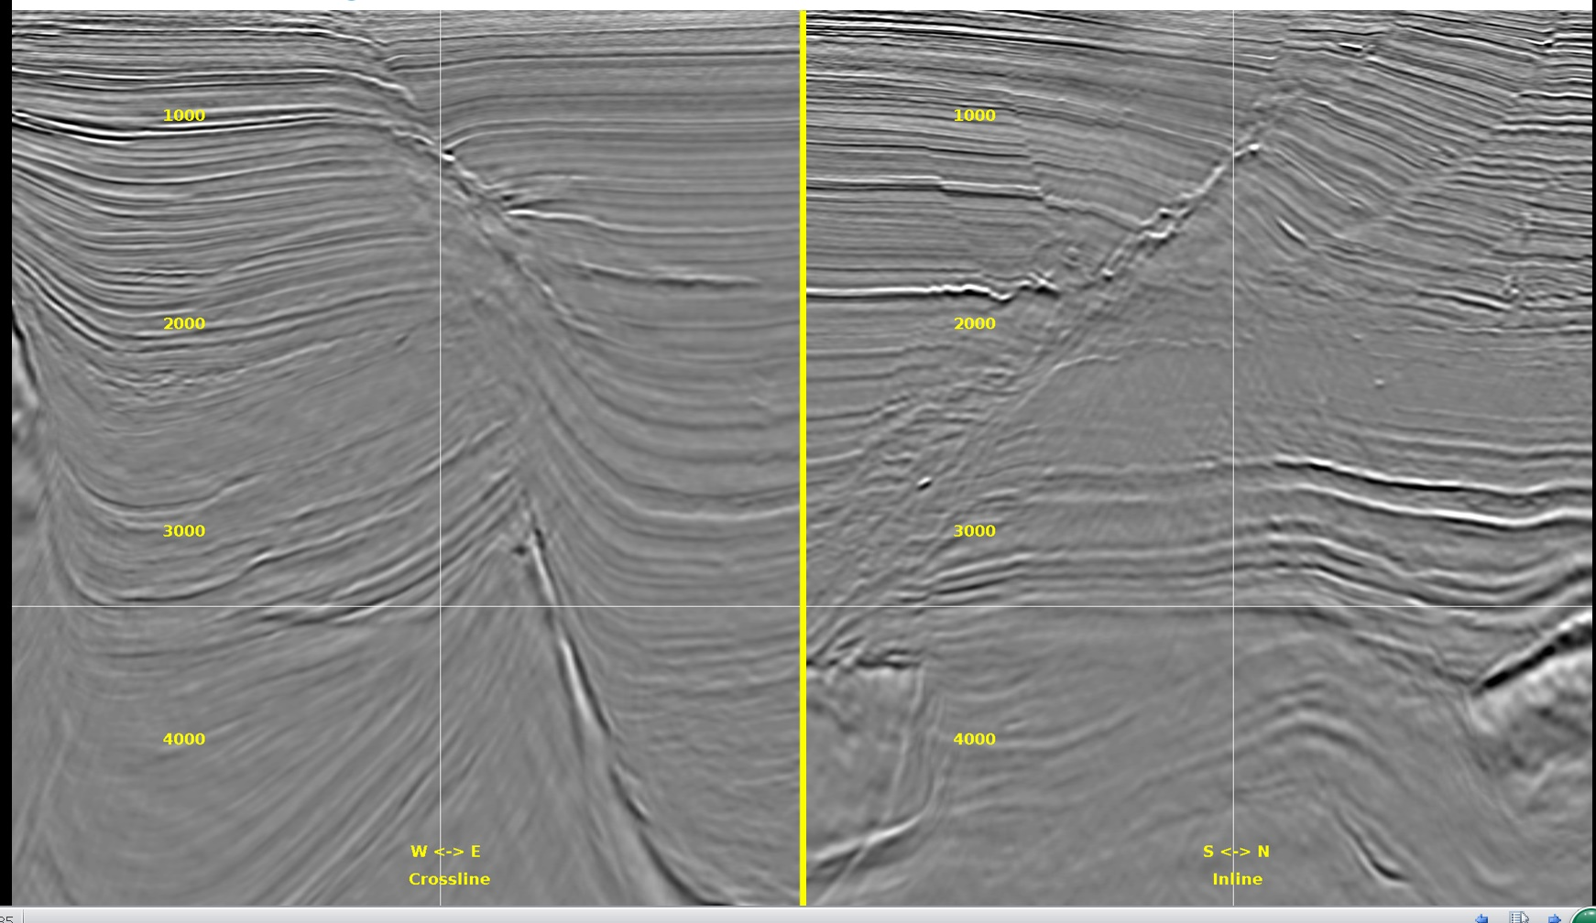
Our ultimate goal is to answer: Where is oil?
Data acquisition
Data processing
Let’s drill a well here. Good luck!
Data analysis
Data imaging

Slide 3
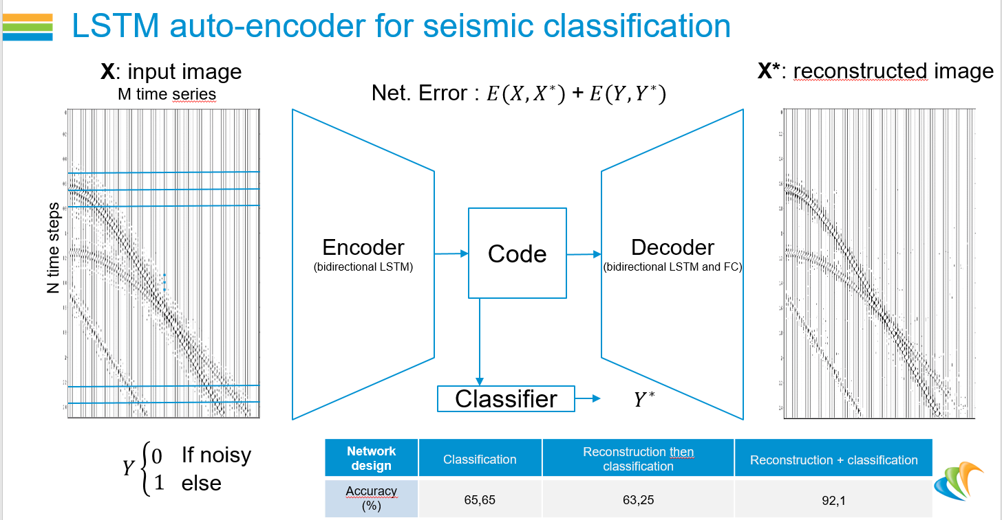
Application of LSTM in noise classification

Slide 4
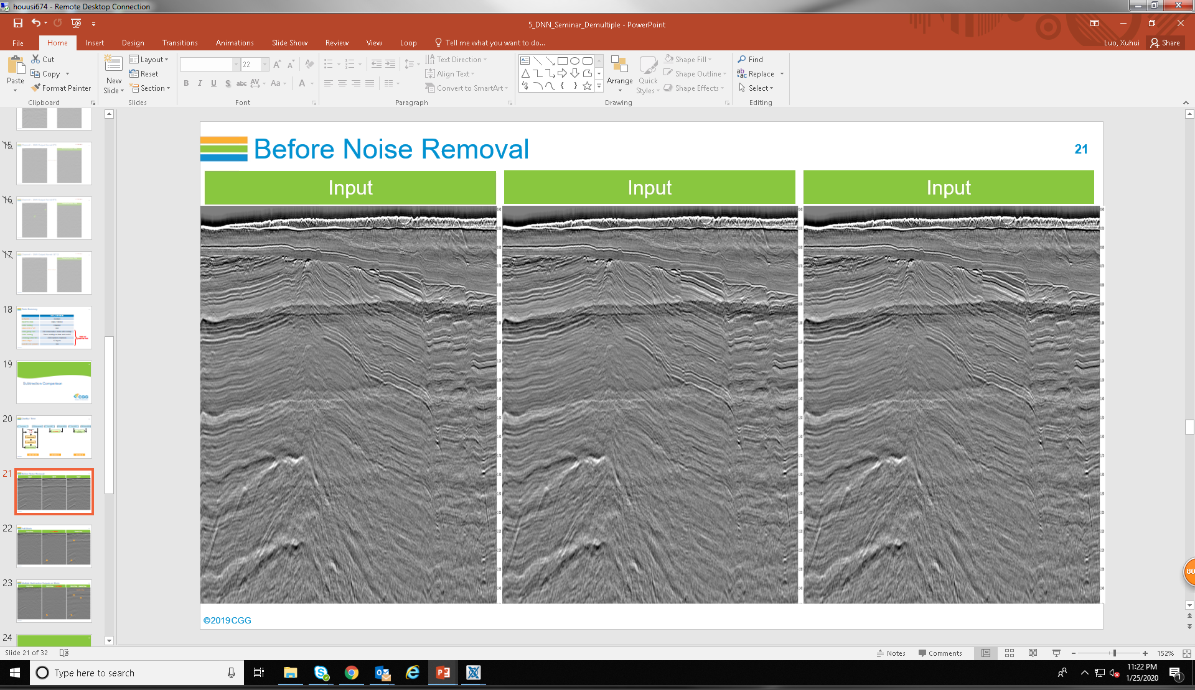
Application of DNN in Noise Removal

Slide 5

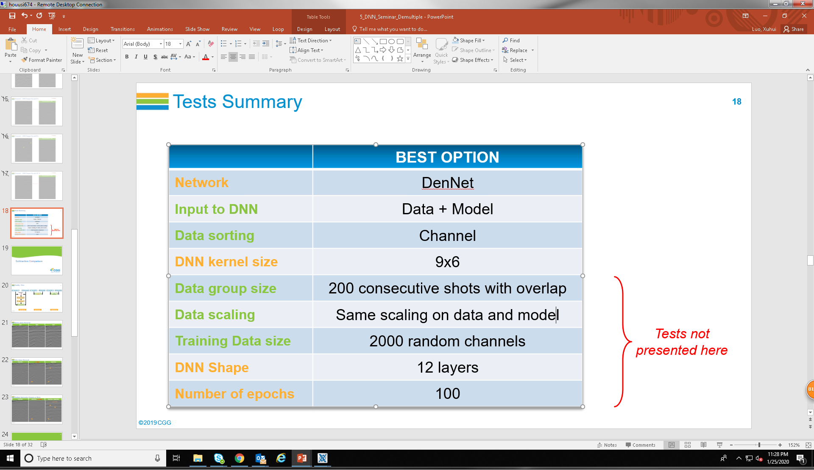
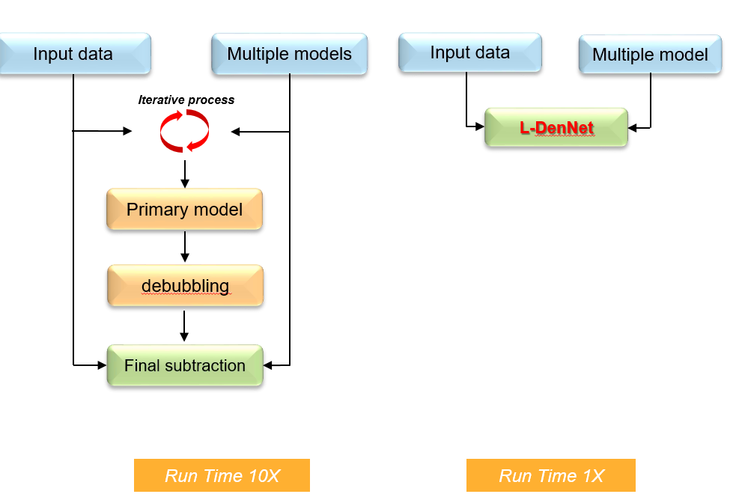
Application of DNN in Noise Removal

